Slide 1
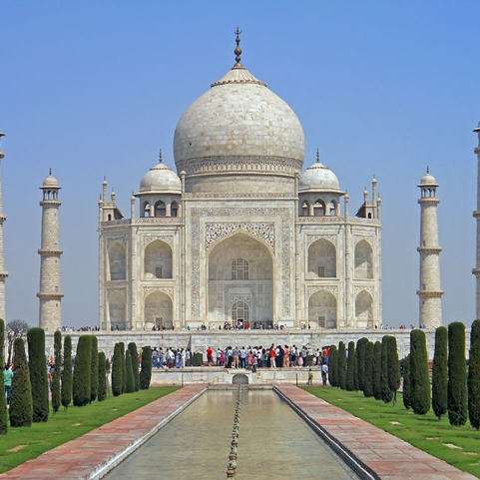

Interactive Showcase
Taj Mehal
Taj Mehal
This is the explanation
This is the explanation

Slide 2
Interactive Showcase
Taj Mehal
Taj Mehal
This is the explanation
This is the explanation

